Slide 1
Dynamic Pricing Competition
LEARNING OPTIMIZATION · BHT BERLIN
Presentation #1 — Linear regression & capacity utilization curves
Simon & Alois · 3 November 2026
Notes:
Speaker: Alois (≈30 s). Welcome everyone. We are Simon and Alois, and in this first presentation we show where our pricing algorithms stand after four weeks: how we built the capacity utilization curves, how we estimate the demand with linear regression, and what the DPC results tell us. Simon and I each built our own algorithm, so we will also compare the two approaches.

Slide 2
Where we are after four weeks
AGENDA
Goals, current status, our two algorithms
Capacity utilization curves
Demand model by linear regression
Performance evaluation
What worked, what didn’t, next steps
DPC · Presentation #1
Alois · 2
Notes:
Speaker: Alois (≈20 s). We follow the five points asked for the presentation: our goals and the status of our two algorithms, then the two topics of this presentation, capacity utilization curves and linear regression, then the performance on the DPC and in a common simulator, and finally what worked, what did not, and what comes next. We alternate on every part.

Slide 3
What we want the algorithm to do
1 · GOALS AND STATUS
Beat the competitor
Sell 80 seats at the right pace
Respect the platform
The ranking counts, not the revenue alone: more revenue than the other airline in each simulation.
Answer in 0.2 s on average, no file writes, 99% of requests error-free.
No stockout long before day 100, no empty seats left at departure.
Status: one shared structure, two ways to learn the demand. Simon learns it offline, from past competitions. Alois re-learns it online, during each season. Both are on the DPC.
DPC · Presentation #1
Alois · 3
Notes:
Speaker: Alois (≈1 min). Our first goal is to win: the platform ranks us against the competitor, so a low revenue can still be a win if the competitor earns even less. Second, we have 80 seats and 100 days: we must not sell out too early, and we must not keep empty seats at the end. Third, the platform constraints: average answer under 0.2 seconds, no file writes, almost no errors. Current status: we share the same structure but learn the demand in two different ways. Simon learns it offline, from all our past results; I re-learn it online, during each season. Comparing the two is one thread of this presentation.

Slide 4

Our pricing algorithm in three steps
1 · GOALS AND STATUS
1
2
3
Target curve
Demand model
Correction
How many seats should be sold by today?
Linear regression gives the revenue-maximizing price p*.
Too fast → raise the price. Too slow → lower it.
Special cases: competitor sold out (monopoly rule), our own stockout, safety nets when seats run out too fast.
DPC · Presentation #1
Simon · 4
Notes:
Speaker: Simon (≈1 min 30). Every day the platform calls our function p and we return a price. Both of our algorithms follow the same three steps. Step 1: the target curve tells us how many seats we should have sold by today. Step 2: a demand model estimated by linear regression gives the price that maximizes the expected revenue, given the competitor price. Step 3: we compare our real sales with the target: if we sell too fast we raise the price, if we sell too slowly we lower it. On top of that there are special cases, the most important one being the monopoly situation, when the competitor has sold all its seats. Steps 1 and 2 are exactly the two topics of today: capacity utilization curves and linear regression.

Slide 5
Same start, two directions
1 · GOALS AND STATUS
Week | Simon — learn offline | Alois — learn online
W2 - same start | Shared base: follow a target curve, reference price = 50% last price + 50% competitor price | Shared base: follow a target curve, reference price = 50% last price + 50% competitor price
W3 | OLS fitted on one past competition, optimal price p* | OLS re-fitted every update on the current season, 50% p* + 50% curve price
W4 | OLS pooled on 16 competitions, target margins, ARIMA, model-based monopoly price | ARX(1) with yesterday’s demand, 40% p*, weaker competitor anchor, scarcity monopoly price
DPC · Presentation #1
Alois · 5
Notes:
Speaker: Alois (≈1 min 15). We started week 2 from the same base: follow a target curve, and set a reference price halfway between our last price and the competitor’s. In week 3, with the regression, we split. Simon fitted the demand model once, on past competitions, and used its optimal price. I re-fit the regression during the season, on the data of the current season only, and mixed its optimum with the curve price. In week 4 Simon pooled 16 competitions and added margins, ARIMA and a new monopoly rule; I added yesterday’s demand to the regression, an ARX model, and made the competitor anchor weaker. Offline versus online: that is the question we will try to answer with the results.

Slide 6
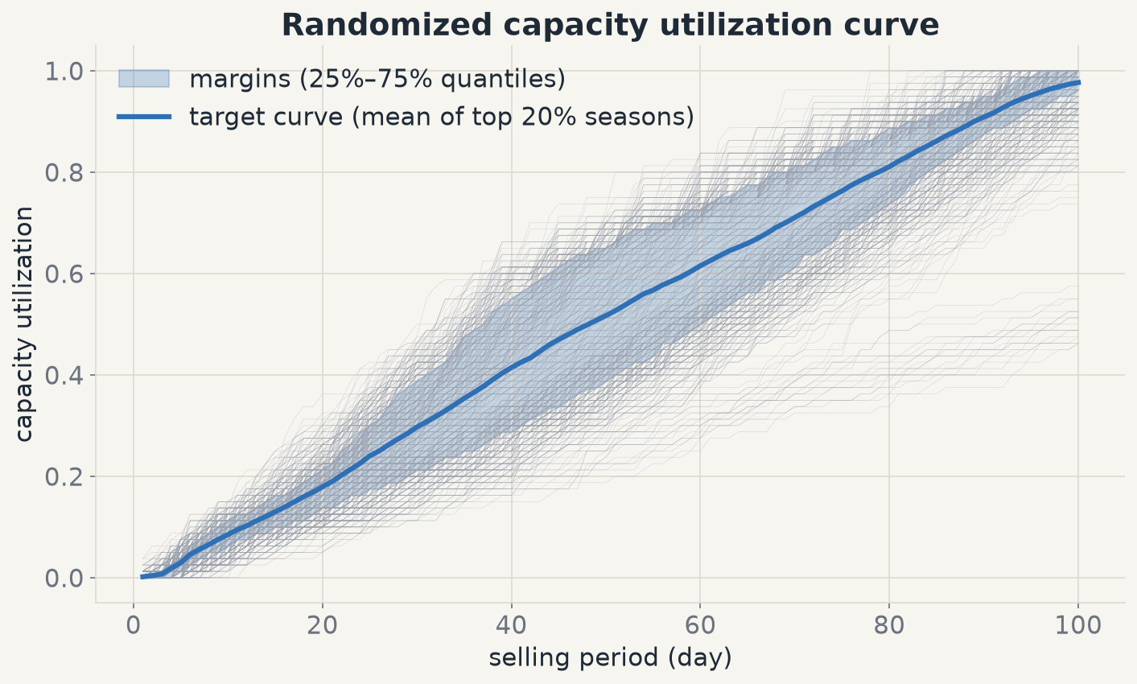
A target curve with margins
2 · CAPACITY UTILIZATION CURVES
Target = mean cumulative sales of the 20% best-paying seasons (16 competitions).
Margins = 25% / 75% quantiles. Day 50: 31 · 41 · 52 seats.
Sales are Poisson-random: inside the margins we keep the price.
DPC · Presentation #1
Simon · 6
Notes:
Speaker: Simon (≈1 min 15). This is the capacity utilization curve, step 1, as I built it for my week-4 version. Each grey line is one selling season: the share of the 80 seats sold day after day. As in the week-2 notebook, we keep the 20 percent of seasons that earned the most and take their mean: that is the blue target curve. New this week: daily sales are random, a Poisson process, so being two seats behind the target can simply be bad luck. We therefore added margins, the 25 and 75 percent quantiles of those best seasons. At day 50 the target is 41 seats, and anything between 31 and 52 is considered normal: we do not change the price. We only correct when sales leave the band.

Slide 7
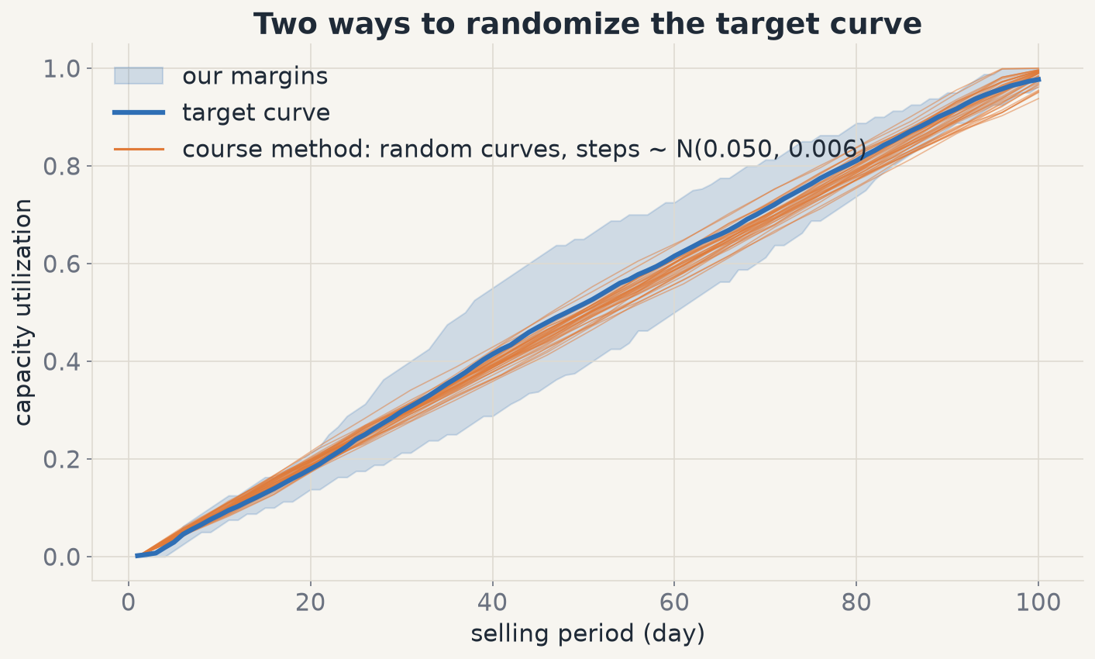
Randomized curves: course method vs. margins
2 · CAPACITY UTILIZATION CURVES
Course method: 5-day steps drawn from N(0.050, 0.006), a new curve every season.
Random steps cancel out: only ±1.4 seats at day 50.
Simulated revenue: 2080 vs. 2096 with margins. We keep the margins; the course method stays an option.
DPC · Presentation #1
Alois · 7
Notes:
Speaker: Alois (≈1 min 15). The course proposed another way to randomize the curve: measure how much the target grows every five days, fit a normal distribution on those steps, and draw a new random curve for every season. We implemented it: these are the orange curves. On our data the steps vary very little, a standard deviation of 0.006, and twenty random steps compensate each other, so a random curve stays within about 1.4 seats of the target. In simulation it changes almost nothing: 2080 against 2096 with our margins. So we keep the margins as default, and the course method is one switch away in the code.

Slide 8
From a regression to an optimal price
3 · DEMAND MODEL BY LINEAR REGRESSION
demand = a + b · price + c · competitor price
Ordinary least squares · b < 0 (our price), c > 0 (competitor price)
Revenue is a parabola
The open question
R(p) = p · (a + c·p_comp + b·p), maximum at p* = −(a + c·p_comp) / 2b: exact and instant, used by both of us.
Which data estimate a, b, c? Past competitions (offline) or the current season (online)?
DPC · Presentation #1
Simon · 8
Notes:
Speaker: Simon (≈1 min 15). Step 2 is the demand model. Following the course, we fit an ordinary least squares regression: daily demand as a linear function of our price and the competitor price. The coefficient b of our price is negative, c is positive. With a linear demand, revenue is price times demand: a parabola, and its maximum has a closed form, p star equals minus "a" plus "c" times the competitor price, over two "b". We both use this formula: it is exact and instantaneous, no numerical optimizer needed. The real difference between our algorithms is the data used to estimate a, b and c: past competitions, or the current season. The next two slides show both options.

Slide 9
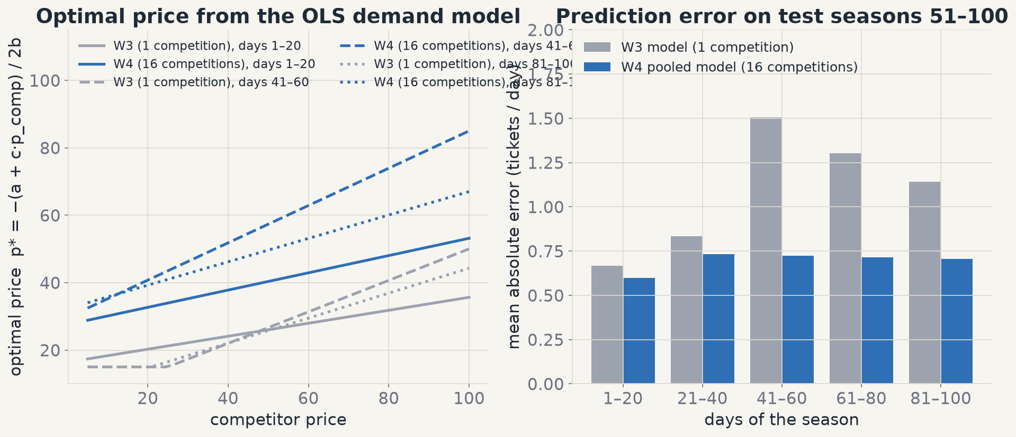
Offline: one competition vs. 16 pooled
3 · DEMAND MODEL BY LINEAR REGRESSION
W3, one competition: p* ≈ 16–25 € — trained on a cheap market, too cheap elsewhere.
W4, 16 competitions: error 0.60–0.73 vs. 0.67–1.51 on seasons 51–100; p* ≈ 33–70 €.
R² only 0.01–0.07: daily demand is mostly Poisson noise.
DPC · Presentation #1
Simon · 9
Notes:
Speaker: Simon (≈1 min 30). Which data do we train on? In week 3 I trained on a single past competition. Problem: in that competition prices were very low, around 17 euros on average, so the model recommended 16 to 25 euros everywhere, and we sold too cheap against stronger competitors. In week 4 I pooled the 16 competitions of my own runs: seasons 1 to 50 for training, 51 to 100 for testing, a time-based split as in the course, and without the days when the competitor is sold out. The prediction error drops in every block, by half in the middle of the season, and the optimal prices become realistic, 33 to 70 euros. One honest remark: the R squared stays very low, below 0.07, because daily demand is mostly 0 or 1 ticket, Poisson noise. The model is still useful: we need the slope, not a perfect fit.

Slide 10
Online: re-estimate during the season
3 · DEMAND MODEL BY LINEAR REGRESSION
demand_t = b0 + b1·p_own + b2·p_comp + φ·demand_t−1
ARX(1), inspired by ARIMA · least squares on the current season’s history, from day 7
Price
+ Adapts
− Little data
p* = −(b0 + b2·p_comp + φ·d_t−1) / 2·b1 if b1 < −0.01, then 40% p* + 60% target-curve price.
Learns the demand of this simulation, which is random on the DPC.
At most 100 points per season, mostly 0 or 1 ticket, and our price must vary.
DPC · Presentation #1
Alois · 10
Notes:
Speaker: Alois (≈1 min 30). My approach takes the opposite direction: instead of learning once on past data, I re-estimate the demand model during each season, with the data of the current season. I added the demand of the previous day as a regressor: an ARX model of order one, inspired by the ARIMA part of the course. From day 7, I solve the least squares problem with numpy, compute the optimal price with the same parabola formula, and use it only if the price coefficient is clearly negative. The final price is 40 percent this optimum and 60 percent the target-curve price. The advantage: on the DPC the demand is drawn randomly for each simulation, and this model follows the demand we actually face. The drawback: very few data points, at most 100 per season and mostly zeros and ones, and the regression only works if our own price varies.

Slide 11
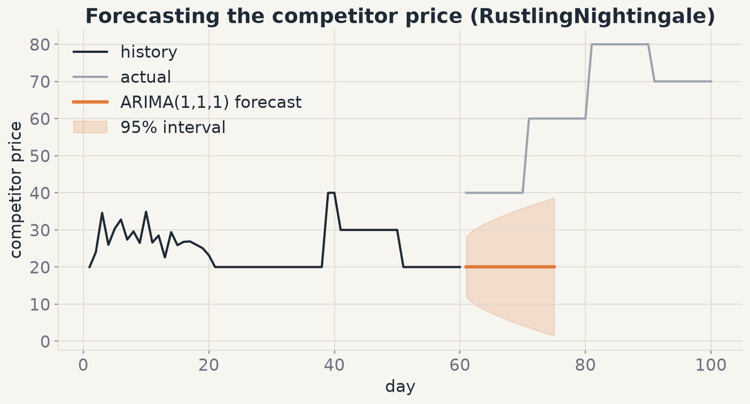
Which competitor price goes into p*?
3 · DEMAND MODEL BY LINEAR REGRESSION
ARIMA(1,1,1) on the competitor price, within the season (18–80 ms per fit).
Error 2.50 € vs. 2.47 € for “yesterday’s price”.
Prices move in steps: yesterday’s price is already a strong forecast.
DPC · Presentation #1
Simon · 11
Notes:
Speaker: Simon (≈50 s). The optimal price depends on the competitor price, but we only know yesterday’s. The course suggested predicting it with a time series model, so I followed the statsmodels ARIMA tutorial: ARIMA(1,1,1), refit on the current season every time we update the price. It is fast enough, 18 to 80 milliseconds. But it does not beat the naive forecast: 2.50 euros of error against 2.47 for simply taking yesterday’s price. It only helps against RustlingNightingale, which changes its price every day. Most competitors keep the same price for several days and then jump, and ARIMA cannot predict a jump. ARIMA stays in the algorithm, but its effect on revenue is close to zero.

Slide 12
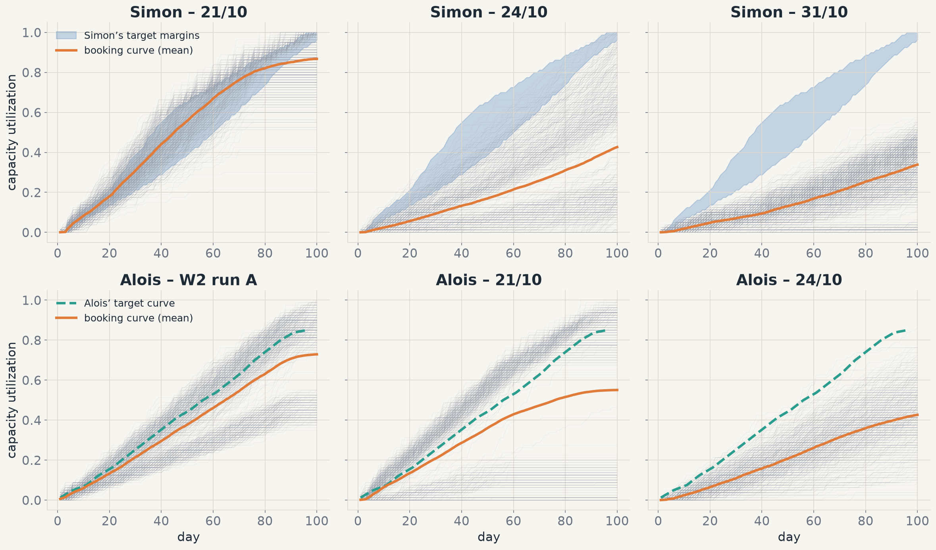
Target curves vs. booking curves on the DPC
4 · PERFORMANCE EVALUATION
21/10, both of us: on track until the competitor sells out (~day 75–80), then flat — 0 to 3 tickets in monopoly at ~130 €.
24/10 and 31/10: low demand, the target is out of reach and prices drift down.
Lesson: a fixed target must adapt to the demand level.
DPC · Presentation #1
Simon · Alois · 12
Notes:
Speakers: Simon (top row) then Alois (bottom row), ≈1 min 45 together. Simon: this is the central chart of today, target curves against real booking curves, top row my runs, bottom row Alois’ runs. On the 21st of October I follow the target almost perfectly until day 75 to 80, then the curve goes flat: that is when the competitor sells out, and my monopoly rule at about 130 euros sold nothing. On the 24th and the 31st the demand was low: the target, built on good seasons, was out of reach and my price drifted down to the floor. Alois: in my runs the picture is the same. On the 21st I stay just below my target, and the curve flattens at the same moment, when the competitor is sold out: 3 tickets in total in monopoly at around 126 euros. On the 24th, low demand, I stay below the target all season. So two different algorithms, the same two lessons: we waste the monopoly phase, and a fixed target curve does not fit every demand level.

Slide 13
Results on the DPC platform
4 · PERFORMANCE EVALUATION
Run | Version | Reported result | Revenue / season | Seats sold
Alois · 21/10 | W3 online | 46th / 75 | 1946 | 44
Alois · 24/10 | W3 online | 43rd / 75 | 817 | 34
Simon · 21/10 | W3 offline | 33% won · rank 51 | 1491 | 69
Simon · 24/10 | W3 offline | 67% won · rank 51 | 588 | 34
Simon · 31/10 | W4 offline | 83% won · rank 15 | 523 | 27
Each of us faced different competitors and demands: these numbers cannot rank our algorithms — hence a common simulator. Alois’ W4 results are not in yet.
DPC · Presentation #1
Alois · 13
Notes:
Speaker: Alois (≈1 min). The official results of both of us. With week 3, I finished 46th and 43rd out of 75; my revenue per season was higher than Simon’s on the same days, but against other competitors. Simon won one competition out of three on the 21st, two out of three on the 24th, and with his week-4 version 83 percent on the 31st, climbing to rank 15, even though his revenue dropped because the demand of that run was very low. The important point: we never met the same competitors or the same demand, so these numbers cannot tell which algorithm is better. My week-4 results are not available yet. That is why we built a common simulator, on the next slides.

Slide 14
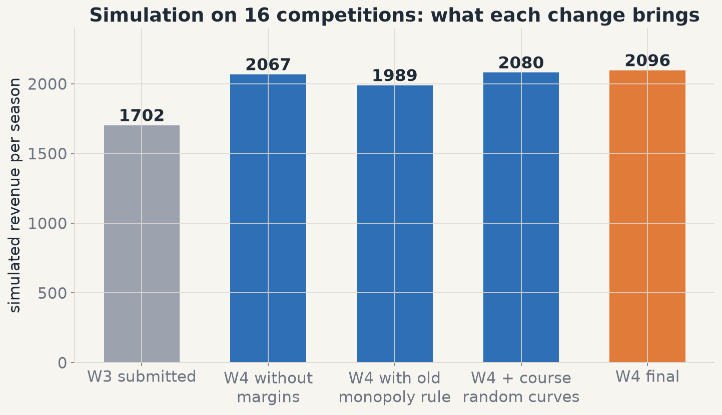
Our simulator: what each W4 change brings
4 · PERFORMANCE EVALUATION
Setup: one OLS demand model per competition (16 “worlds”), competitor prices replayed, Poisson demand, 80 seats.
Simon W4: +23% vs. W3 on his 16 competitions — pooled OLS and monopoly rule; margins +1.4%.
Limit: the simulated competitor never reacts to our price.
DPC · Presentation #1
Simon · 14
Notes:
Speaker: Simon (≈1 min 15). The DPC only gives two or three runs a week, so we built our own simulator. Each past competition becomes a world with its own regression demand model; the competitor’s prices are replayed from the CSV; our demand is drawn from a Poisson distribution and capped at 80 seats. Important detail: the course notebook replayed the historical demand, which does not react to our price, so it cannot evaluate a pricing strategy. With this simulator we can switch each change on and off. On the 16 competitions of my runs, my week 4 brings plus 23 percent over my week 3, but careful: these are also the competitions my model was trained on, so this number is optimistic; the fair comparison comes on the next slide. Most of it comes from the pooled regression and from the new monopoly rule; the margins add 1.4 percent, the course’s random curves nothing. The main limit: the simulated competitor never reacts to us, so a real price war cannot appear.

Slide 15
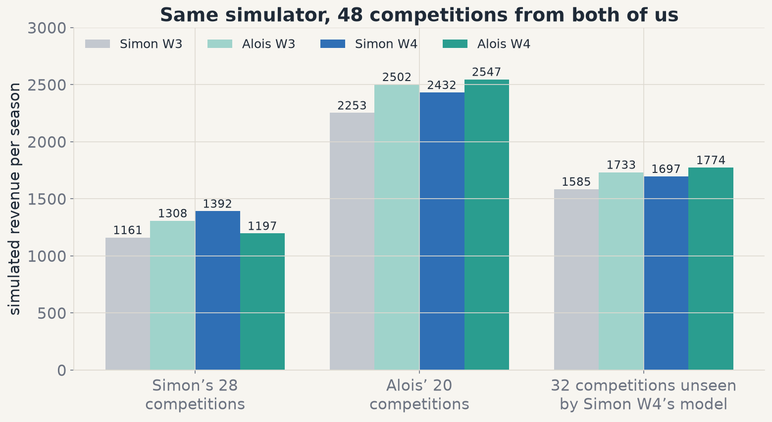
Offline vs. online: a fair comparison
4 · PERFORMANCE EVALUATION
Home advantage: each algorithm wins on its author’s data.
Unseen data: Alois W4 1774 vs. Simon W4 1697 (+4.5%, 65% of seasons).
Both improved from W3 to W4 on unseen data.
DPC · Presentation #1
Alois · 15
Notes:
Speaker: Alois (≈1 min 15). We then put our four versions in the same simulator, with 48 competitions: 28 from Simon’s runs and 20 from mine. First observation: each algorithm wins on the data of its author. Simon’s week-4 model was trained on part of his competitions, so it plays at home there; my target curve comes from my runs. The fair test is the third group: 32 competitions that Simon’s model has never seen. There, my online version earns 1774 per season against 1697, about 4.5 percent more, and wins 65 percent of the seasons. And both of us improved between week 3 and week 4. Our reading: learning the demand of the current simulation generalizes better; learning from many past competitions gives a better start. The next step is obvious: combine both.

Slide 16
Ideas that worked, ideas that didn’t
5 · WHAT WORKED, WHAT DIDN’T
Worked
Didn’t work
Closed-form optimal price p*
Online regression: best on unseen data
Pooled regression: better than 1 competition
Margins around the target (+1.4%)
Our own simulator to compare fairly
Monopoly at ~130 €: 0–3 tickets, both of us
Fixed target in low-demand runs
Offline model from one competition
ARIMA: no better than yesterday’s price
Course random curves: spread too small
DPC · Presentation #1
Simon · 16
Notes:
Speaker: Simon (≈1 min 15). To sum up. What worked: the closed-form optimal price; Alois’ online regression, which generalizes best to new competitions; pooling the offline regression over many competitions instead of one; the margins around the target curve; and building our own simulator, without which we could not compare our two algorithms. What did not work: the monopoly phase, where both of us sold almost nothing at around 130 euros; a fixed target curve when the demand is low; an offline model trained on a single competition; ARIMA, which does not beat yesterday’s price because competitors change their price in steps; and the course’s random curves, whose spread is too small on our data.

Slide 17
Where we go next
5 · NEXT STEPS
Problem | Next step | Course
Fixed target in low demand | Scale the target to the observed demand level | 5 Jan
Offline vs. online model | Pooled model as a start, updated online | 17 Nov
80 seats ignored in p* | Capacity-constrained price optimization | 10 Nov
Competitor sold out | Exploit the monopoly phase properly | 15 Dec
DPC · Presentation #1
Alois · 17
Notes:
Speaker: Alois (≈1 min). Our next steps follow the course. First, the target curve must adapt to the demand level we observe, for example by grouping competitions with similar demand, which is the topic of the 5th of January. Second, combine our two approaches: start from Simon’s pooled model and update it online with my method; the Bertsimas and Perakis learning approach on the 17th of November is exactly about that. Third, our optimal price ignores the 80-seat capacity: constrained optimization with scipy and Pyomo comes on the 10th of November. Finally, the monopoly phase: our current fix is temporary, and the course of the 15th of December covers how to exploit a sold-out competitor.

Slide 18
Thank you — questions?
DPC · PRESENTATION #1
2 ways
48
1 plan
to learn the demand: offline and online
competitions in a common simulator
combine both approaches
Simon & Alois
Notes:
Speakers: Simon and Alois (≈15 s). Simon: to conclude, two ways to learn the demand, offline and online, compared fairly in a common simulator of 48 competitions. Alois: and one plan for the coming weeks, combining both approaches. Thank you for your attention, we are happy to take your questions.

